Slide 1

Chapter 6
Bandwidth Utilization:
Multiplexing
6.<number>
Copyright © The McGraw-Hill Companies, Inc. Permission required for reproduction or display.

Slide 2

Note
Bandwidth utilization is the wise use of
available bandwidth to achieve
specific goals.
Efficiency can be achieved by multiplexing;
6.<number>

Slide 3
6-1 MULTIPLEXING
Whenever the bandwidth of a medium linking two devices is greater than the bandwidth needs of the devices, the link can be shared.
Multiplexing is the set of techniques that allows the simultaneous transmission of multiple signals across a single data link.
As data and telecommunications use increases, so does traffic.
6.<number>

Slide 4

A MUX is used to combine n input lines into a single stream. At the receiver, DEMUX is used to separate the stream back into its component transmissions
Channel refers to the portion of a link that carries a transmission between given pair of lines.
Figure 6.1 Dividing a link into channels
6.<number>

Slide 5

Figure 6.2 Categories of multiplexing
6.<number>

Slide 6

Frequency-division multiplexing
In FDM , signals generated by each sending device modulate different carrier frequencies
These modulated signals are combined to into single composite signal that can be transported by the link
Channels can be separated by strips of unused bandwidth (guard bands)
Figure 6.3 Frequency-division multiplexing
6.<number>

Slide 7
Note
FDM is an analog multiplexing technique that combines analog signals.
6.<number>

Slide 8

Figure 6.4 FDM process
6.<number>

Slide 9

Figure 6.5 FDM demultiplexing example
6.<number>

Slide 10

6.<number>

Slide 11
Example 6.1
Assume that a voice channel occupies a bandwidth of 4 kHz. We need to combine three voice channels into a link with a bandwidth of 12 kHz, from 20 to 32 kHz. Show the configuration, using the frequency domain. Assume there are no guard bands.
Solution
We shift (modulate) each of the three voice channels to a different bandwidth, as shown in Figure 6.6. We use the 20- to 24-kHz bandwidth for the first channel, the 24- to 28-kHz bandwidth for the second channel, and the 28- to 32-kHz bandwidth for the third one. Then we combine them as shown in Figure 6.6.
6.<number>

Slide 12

Figure 6.6 Example 6.1
6.<number>

Slide 13
Example 6.2
Five channels, each with a 100-kHz bandwidth, are to be multiplexed together. What is the minimum bandwidth of the link if there is a need for a guard band of 10 kHz between the channels to prevent interference?
Solution
For five channels, we need at least four guard bands. This means that the required bandwidth is at least
5 × 100 + 4 × 10 = 540 kHz,
as shown in Figure 6.7.
6.<number>

Slide 14

Figure 6.7 Example 6.2
6.<number>

Slide 15

FDM applications :
Multiplexing telephone lines
Figure 6.9 Analog hierarchy
6.<number>

Slide 16
FDM applications
AM and FM radio broadcasting
Television broadcasting
First generation of cellular telephones
6.<number>

Slide 17

Figure 6.12 TDM
6.<number>

Slide 18
Note
TDM is a digital multiplexing technique for combining several low-rate
channels into one high-rate one.
6.<number>

Slide 19

Synchronous time-division multiplexing
Figure 6.13 Synchronous time-division multiplexing
6.<number>

Slide 20
6.<number>

Slide 21
Example 6.5
In Figure 6.13, the data rate for each input connection is 1 kbps. If 1 bit at a time is multiplexed (a unit is 1 bit), what is the duration of (a) each input slot, (b) each output slot, and (c) each frame?
Solution
We can answer the questions as follows:
a. The data rate of each input connection is 1 kbps. This means that the bit duration is 1/1000 s or 1 ms. The duration of the input time slot is 1 ms (same as bit duration).
6.<number>

Slide 22
Example 6.5 (continued)
b. The duration of each output time slot is one-third of the input time slot. This means that the duration of the output time slot is 1/3 ms.
c. Each frame carries three output time slots. So the duration of a frame is 3 × 1/3 ms, or 1 ms. The duration of a frame is the same as the duration of an input unit.
6.<number>

Slide 23

Figure 6.15 Interleaving
6.<number>

Slide 24
Example 6.8
Four channels are multiplexed using TDM. If each channel sends 100 bytes /s and we multiplex 1 byte per channel, show the frame traveling on the link, the size of the frame, the duration of a frame, the frame rate, and the bit rate for the link.
Solution
The multiplexer is shown in Figure 6.16. Each frame carries 1 byte from each channel; the size of each frame, therefore, is 4 bytes, or 32 bits.
Because each channel is sending 100 bytes/s and a frame carries 1 byte from each channel, the frame rate must be 100 frames per second. The bit rate is 100 × 32, or 3200 bps.
6.<number>

Slide 25

Figure 6.16 Example 6.8
6.<number>

Slide 26
Example 6.9
A multiplexer combines four 100-kbps channels using a time slot of 2 bits and the link carries 50,000 frames per second. Show the output with four arbitrary inputs. What is the frame rate? What is the frame duration? What is the bit rate? What is the bit duration?
Solution
Figure 6.17 shows the output for four arbitrary inputs. The link carries 50,000 frames per second. The frame duration is therefore 1/50,000 s or 20 μs. The frame rate is 50,000 frames per second, and each frame carries 8 bits; the bit rate is 50,000 × 8 = 400,000 bits or 400 kbps. The bit duration is 1/400,000 s, or 2.5 μs.
6.<number>

Slide 27

Figure 6.17 Example 6.9
6.<number>

Slide 28

Figure 6.18 Empty slots
6.<number>

Slide 29

Figure 6.19 Multilevel multiplexing
6.<number>

Slide 30

Figure 6.20 Multiple-slot multiplexing
6.<number>

Slide 31

Figure 6.21 Pulse stuffing
6.<number>

Slide 32

Frame Synchronization
Figure 6.22 Framing bits
6.<number>

Slide 33

Figure 6.23 Digital hierarchy
6.<number>

Slide 34

Table 6.1 DS and T line rates
6.<number>

Slide 35
Statistical Time Division Multiplexing
Slot is allotted if an input line has data to send
Addressing
No Synchronization bits
Bandwidth is always less than the sum of the capacities of each channel.
6.<number>

Slide 36

Figure 6.26 TDM slot comparison
6.<number>

Slide 37
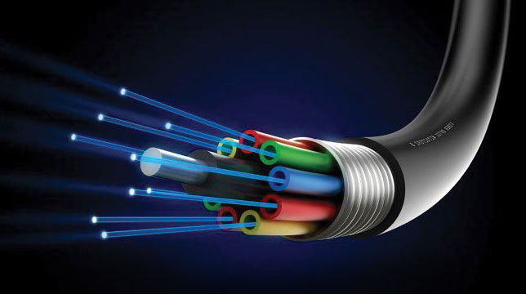
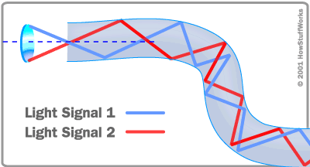
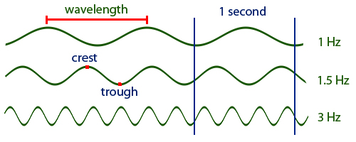
6.<number>

Slide 38
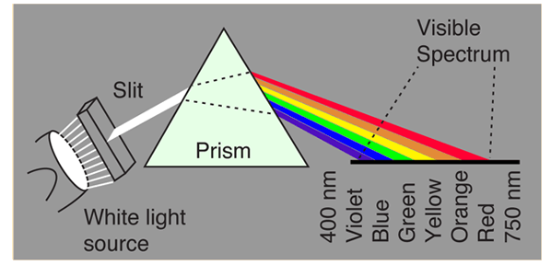
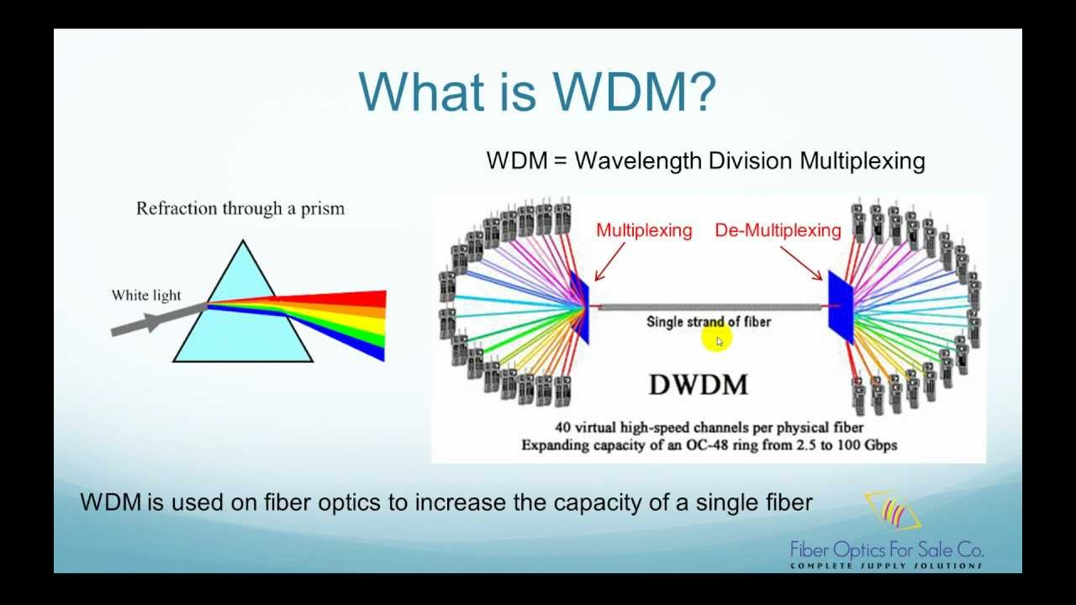
6.<number>

Slide 39

Figure 6.10 Wavelength-division multiplexing
6.<number>

Slide 40
Note
WDM is an analog multiplexing technique to combine optical signals.
6.<number>

Slide 41

Figure 6.11 Prisms in wavelength-division multiplexing and demultiplexing
6.<number>

Slide 42
SONET
In 1966 Charles Kao reported the feasibility of optical fibers that could be used for communications. By 1977 a DS3 45 Mbps fiber optic system was demon- started in Chicago.
The first generation of equipment for optical fiber transmission was proprietary, and no standards were available for the interconnection of equipment from different vendors.
To meet the urgent need for standards to interconnect optical transmission systems, the Synchronous Optical Network (SONET) standard was developed in North America. The CCITT later developed a corresponding set of standards called Synchronous Digital Hierarchy (SDH).
6.<number>

Slide 43
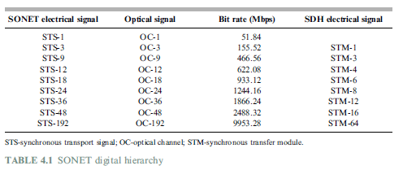
6.<number>

Slide 44
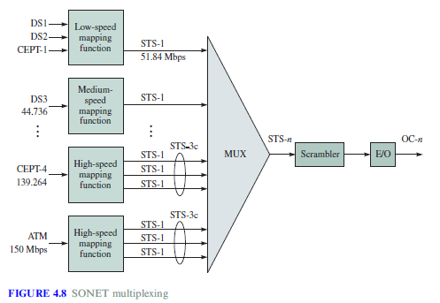
6.<number>

Slide 45
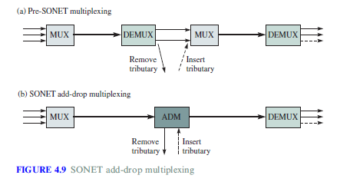
6.<number>

Slide 46
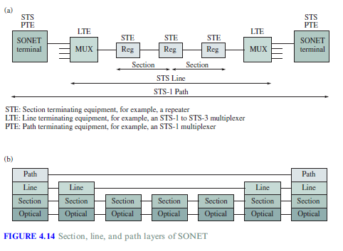
SONET FRAME STRUCTURE
6.<number>

Slide 47
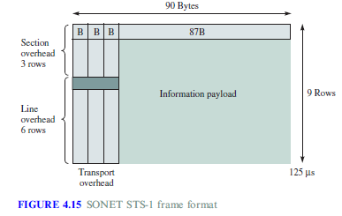
6.<number>

Slide 48
SONET uses a frame structure that has the same 8 kHz repetition rate as traditional TDM systems.
The structure of the SONET STS-1, A frame consisting of a rectangular array of bytes arranged in 9 rows by 90 bytes is repeated 8000 times a second
8*9*90*8000= 51.84 Mbps.
The first three columns of the array are allocated for section and line, for control functions such as frame no., error monitoring.
The remaining 87 columns are used for information payload.
6.<number>

